Slide 1
Building Blocks Infographics
Here is where this template begins

Slide 2
Building blocks infographics
Mercury
Mercury is the closest planet to the Sun
Venus
Earth
Venus has a really beautiful name
Earth is the third planet from the Sun
Mars
Jupiter
Saturn
Despite being red, Mars is a cold place
Jupiter is a gas giant and the biggest planet
Saturn is a gas giant and has several rings

Slide 3
Building blocks infographics
Neptune
Jupiter
Neptune is the farthest planet from the Sun
Jupiter is the biggest planet in the entire Solar System
Mercury
Earth
Mercury is the smallest planet in the entire Solar System
Earth is third planet from the Sun and the only one that harbors life

Slide 4
Building blocks infographics
01
Mercury is the smallest planet
02
03
Venus has a really beautiful name
Earth is the third planet from the Sun
04
05
06
Mars is red and cold
Jupiter is the biggest planet
Saturn is a gas giant with rings

Slide 5
Building blocks infographics
Neptune - 25%
Jupiter - 25%
Neptune is far away from Earth
Jupiter is the biggest planet of them all
Pluto - 25%
Ceres - 25%
It’s now considered a dwarf planet
Ceres is located in the main asteroid belt

Slide 6
Building blocks infographics
03
Jupiter
02
Jupiter is a gas giant and the biggest planet
Saturn
01
Saturn is a gas giant and has several rings
Neptune
Neptune is the farthest planet from the Sun

Slide 7
Building blocks infographics
Saturn
Neptune
Saturn is a gas giant, composed of hydrogen and helium
Neptune is the farthest planet from the Sun
The Sun
Mercury
The Sun is the star at the center of the Solar System
Mercury is the smallest planet of them all

Slide 8
Building blocks infographics
Mercury - 1
Mercury is the smallest planet
Mars - 7
Venus - 3
Despite being red, Mars is a cold place
Venus is the second planet from the Sun
Jupiter - 9
Earth - 5
Jupiter is the biggest planet of them all
Earth is the only one that harbors life

Slide 9
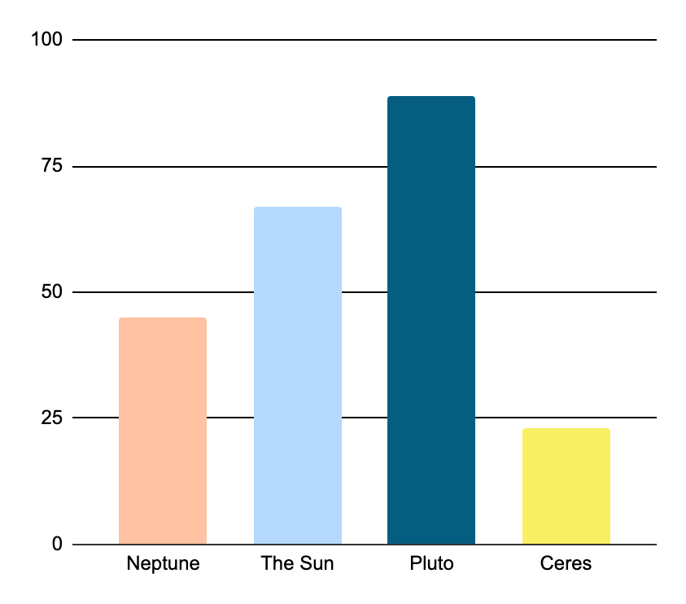
Building blocks infographics
45%
67%
100
75
Neptune
The Sun
50
Neptune is far away from Earth
It’s the star at the center of our System
25
89%
23%
0
Neptune
The Sun
Pluto
Ceres
Pluto
Ceres
Follow the link in the graph to modify its data and then paste the new one here. For more info, click here
It’s now considered a dwarf planet
Ceres is located in the main asteroid belt

Slide 10
Building blocks infographics
Mercury - 20%
Venus - 40%
Earth - 60%
Mars - 80%
Jupiter - 100%
Mercury is the smallest planet
Venus has a beautiful name
Earth is the third planet from the Sun
Despite being red, Mars is a cold place
Jupiter is the biggest planet of them all

Slide 11
Building blocks infographics
Jupiter - 7%
Jupiter is a gas giant and the biggest planet in the Solar System
Saturn - 25%
Saturn is a gas giant and has several rings
Neptune - 68%
Neptune is the farthest planet from the Sun. It's cold there

Slide 12
Building blocks infographics
Mars is actually a cold place
Jupiter is the biggest planet
Saturn is a gas giant and has rings
Step 2
Step 4
Step 6
Step 1
Step 3
Step 5
Step 7
Neptune is far away from Earth
Mercury is the smallest planet
Pluto is considered a dwarf planet
Ceres is in the main asteroid belt

Slide 13
Building blocks infographics
Mercury | Venus | Earth | Mars | Jupiter | Saturn | Neptune
10% | 20% | 10% | 10% | 20% | 20% | 10%
Mercury is the closest planet to the Sun | Venus is the second planet from the Sun | Earth is the third planet from the Sun | Despite being red, Mars is a cold place | Jupiter is the biggest planet of them all | Saturn is a gas giant and has rings | Neptune is the farthest planet from the Sun

Slide 14
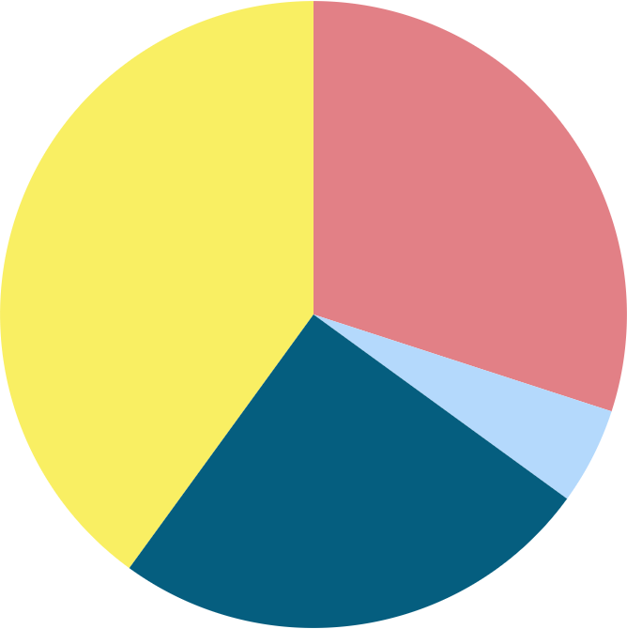
Building blocks infographics
Saturn - 40%
Neptune - 30%
Saturn is a gas giant and has several rings
Neptune is the farthest planet from the Sun
The Sun - 25%
Pluto - 5%
The Sun is the star at the center of the Solar System
Pluto is now considered a dwarf planet
* To modify this graph, click on it, follow the link, change the data and paste the new graph here, replacing this one.
You can see how to modify the graph here

Slide 15
Building blocks infographics
01
Building
Mercury is the closest planet to the Sun and the smallest one in the entire Solar System
02
Constructing
Venus has a very beautiful name but is actually terribly hot, hotter than Mercury
03
Blocking
Jupiter is a huge gas giant named after the Roman god of the skies and the lightning

Slide 16
Building blocks infographics
Stage | Yellow | Blue | Red
#1 | 56 | 23 | 2
#2 | 10 | 89 | 67
#3 | 7 | 12 | 8
#4 | 36 | 69 | 15

Slide 17
Building blocks infographics
30%
20%
Mercury is a very small planet
Jupiter is the biggest planet
40%
10%
Despite being red, Mars is actually cold
Venus has a really beautiful name

Slide 18
Building blocks infographics
Venus
Venus is the second planet from the Sun
02
Mercury
Earth
01
03
Mercury is the closest planet to the Sun and the smallest one
Earth is the third planet from the Sun and the only one with life

Slide 19
Building blocks infographics
Main idea
Mercury
Venus
Earth
Mercury is the closest planet to the Sun
Venus is the second planet from the Sun
Earth is the third planet from the Sun

Slide 20
Building blocks infographics
Mercury - 01
Earth - 02
List item 1
List item 2
List item 3
List item 4
List item 1
List item 2
List item 3
List item 4
Venus - 04
Mars - 03
List item 1
List item 2
List item 3
List item 4
List item 1
List item 2
List item 3
List item 4

Slide 21
Building blocks infographics
Jupiter - 1/4
Saturn - 2/4
Neptune - 1/4
Jupiter is the biggest planet of them all
Saturn is a gas giant with rings
Neptune is far away from Earth

Slide 22
Building blocks infographics
The Sun
The Sun is the star at the center of the Solar System
Pluto
Main idea
Pluto is now considered a dwarf planet
Ceres
Ceres is located in the main asteroid belt

Slide 23
Building blocks infographics
Earth
Mercury
Mars
Venus
Saturn
Earth is the planet we all live on
Mercury is the smallest planet
Despite being red, it’s actually a cold place
It’s terribly hot, even hotter than Mercury
Saturn is a gas giant and has several rings
3
2
4
1
5

Slide 24
Building blocks infographics
Venus
Venus has a beautiful name and is the second planet from the Sun
1
Jupiter
Jupiter is a gas giant and the biggest planet in the Solar System
2
Mercury
Mercury is the closest planet to the Sun and the smallest one
3
Mars
Despite being red, Mars is actually a cold place full of iron oxide dust
4

Slide 25
Building blocks infographics
Venus
Venus has a beautiful name and is the second planet from the Sun
1
Jupiter
Jupiter is a gas giant and the biggest planet in the Solar System
2
Mercury
Mercury is the closest planet to the Sun and the smallest one
3
Mars
Despite being red, Mars is actually a cold place full of iron oxide dust
4

Slide 26
Building blocks infographics
Mercury
Venus
Mercury is the smallest planet in the Solar System
Venus is terribly hot, even hotter than Mercury
Saturn
Mars
Saturn is a gas giant and has several rings
Despite being red, Mars is actually a cold place
Jupiter
Earth
Jupiter is the biggest planet in the Solar System
Earth is the planet where we all live

Slide 27
Building blocks infographics
Venus - 1/3
Venus has a beautiful name, but it’s very hot
Neptune - 1/3
This is the farthest planet from the Sun
Saturn - 1/3
Saturn is a gas giant with several rings

Slide 28
Building blocks infographics
Color | #
Red | 5
Dark blue | 4
Baby blue | 5
Yellow | 4
Peach | 3
Counting building blocks

Slide 29
Building blocks infographics
Venus - 20%
Earth - 20%
Venus is terribly hot, even hotter than Mercury
Earth is the planet where we all live
Mercury - 20%
Mars - 40%
Mercury is the smallest planet in the Solar System
Despite being red, Mars is actually a cold place

Slide 30
Building blocks infographics
Earth
Earth is the only planet with life
Jupiter
C
Saturn
B
D
It’s the biggest planet of them all
It’s a gas giant and has several rings
Neptune
Mercury
A
E
It’s the farthest planet from the Sun
It’s the closest planet to the Sun

Slide 31
Building blocks infographics
Mercury - 3%
Venus - 40%
Earth - 17%
Mars - 30%
Jupiter - 10%
Mercury is the smallest planet
Venus has a beautiful name
Earth is the third planet from the Sun
Despite being red, Mars is a cold place
Jupiter is the biggest planet of them all

Slide 32
Instructions for use (premium users)
In order to use this template, you must be a Premium user on Slidesgo.
You are allowed to:
Modify this template.
Use it for both personal and commercial purposes.
Hide or delete the “Thanks” slide and the mention to Slidesgo in the credits.
Share this template in an editable format with people who are not part of your team.
You are not allowed to:
Sublicense, sell or rent this Slidesgo Template (or a modified version of this Slidesgo Template).
Distribute this Slidesgo Template (or a modified version of this Slidesgo Template) or include it in a database or in any other product or service that offers downloadable images, icons or presentations that may be subject to distribution or resale.
Use any of the elements that are part of this Slidesgo Template in an isolated and separated way from this Template.
Register any of the elements that are part of this template as a trademark or logo, or register it as a work in an intellectual property registry or similar.
For more information about editing slides, please read our FAQs or visit Slidesgo School:
https://slidesgo.com/faqs and https://slidesgo.com/slidesgo-school

Slide 33
Infographics
You can add and edit some infographics to your presentation to present your data in a visual way.
Choose your favourite infographic and insert it in your presentation using Ctrl C + Ctrl V or Cmd C + Cmd V in Mac.
Select one of the parts and ungroup it by right-clicking and choosing “Ungroup”.
Change the color by clicking on the paint bucket.
Then resize the element by clicking and dragging one of the square-shaped points of its bounding box (the cursor should look like a double-headed arrow). Remember to hold Shift while dragging to keep the proportions.
Group the elements again by selecting them, right-clicking and choosing “Group”.
Repeat the steps above with the other parts and when you’re done editing, copy the end result and paste it into your presentation.
Remember to choose the “Keep source formatting” option so that it keeps the design. For more info, please visit Slidesgo School.

